Slide 1


Analyzing Student Academic Performance
SIC – AI802
Notes:
Note:
1

Slide 2
Agenda
  Team Members
  Overview & Data
  EDA
  Data Cleaning
  Data Visualization
  Conclusion & Recommendations
Samsung Innovation Campus

Slide 3
Team Members
Menna Tallah Alaseeel Karm
Omar Ahmed Mohammed
Mostafa Tamer Mohamed
Khaled Erfan
Samsung Innovation Campus

Slide 4
  Overview & Data
Samsung Innovation Campus
Notes:
Note:
2

Slide 5

Project Overview:
Analyze student academic performance and identify the factors that may influence students' scores and passing rates.
What are we trying to understand?
Overall student performance
Differences between subjects
Factors associated with better performance
Students' passing and grade distribution
Samsung Innovation Campus

Slide 6
Dataset
Students Performance in Exams​
Source: Kaggle​
Records: 1000 Students
Samsung Innovation Campus
Notes:
Note:
2

Slide 7
Dataset:
Student Information:
Gender
Race/Ethnicity
Parental Level of Education
Lunch
Test Preparation Course
Academic Information:
Math Score
Reading Score
Writing Score
Derived Features:
Total Score
Average Score
Grade
Pass/Fail
Strongest/Weakest Subject
Samsung Innovation Campus

Slide 8
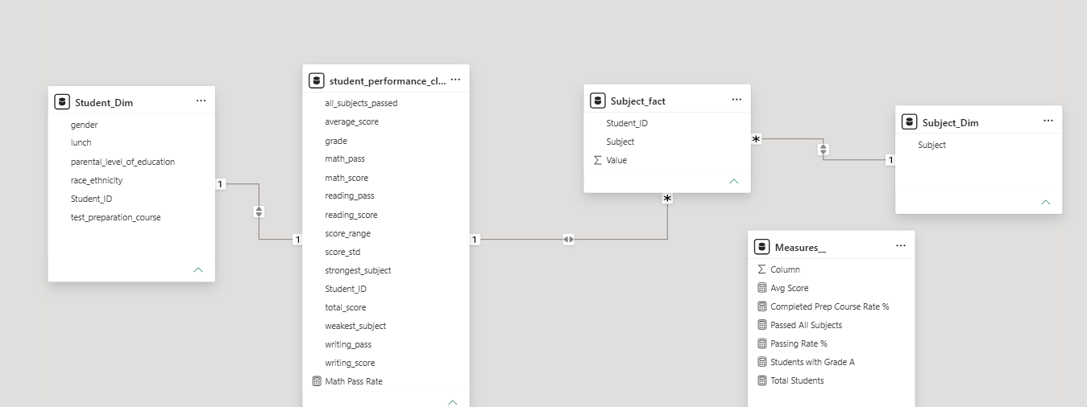
Data structure:
We organized the data into dimension and fact tables to make the analysis more structured and allow better filtering and comparisons.
Samsung Innovation Campus
Notes:
Note:
4

Slide 9
Data Cleaning & Preprocessing
Samsung Innovation Campus
Notes:
Note:
2

Slide 10
Preprocessing:
1. Data Loading & Inspection:
Load the CSV file using pandas
Display first few rows and dataset info
Inspect column names and data types
2. Column Standardization:
Convert column names to lowercase
Replace spaces with underscores
Remove special characters
Example: Math Score → math score
3. Data Type Normalization:
Strip whitespace from string columns
Convert to lowercase for consistency
Handle special characters (e.g., replace "/" with "_")
4. Missing Values & Duplicates Check:
Detect missing/null values per column
Identify and count duplicate rows
Status: No missing values or duplicates found in dataset
Samsung Innovation Campus

Slide 11
5. Data Validation:
Verify test scores are within valid range (0-100)
Identify any invalid score entries
Check for data consistency across subjects
6. Outlier Detection:
Use Interquartile Range (IQR) method for outlier detection
Calculate Q1, Q3, and IQR for each score column
Identify outliers beyond 1.5 × IQR bounds
Note: Outliers are identified but not removed to preserve data integrity
7. Feature Engineering:
Create derived metrics for analysis
Assign grades based on average scores
Generate performance indicators

Slide 12
EDA
Samsung Innovation Campus
Notes:
Note:
2

Slide 13
Exploratory Data Analysis (EDA):
Analyzed the distribution of students' scores across Math, Reading, and Writing.
Calculated descriptive statistics such as mean, median, and standard deviation.
Examined relationships between students' performance and factors such as gender, parental education, lunch type, and test preparation.
Analyzed the correlation between the three subject scores.
Identified the main patterns, differences, and performance trends in the dataset.

Slide 14
Power Bi Modeling:
Organized the data into Fact and Dimension tables with clear relationships.
Created Student and Subject Dimensions using Power Query.
Built DAX Measures to calculate key performance indicators.
Prepared the model for accurate analysis and interactive Dashboard visualizations.

Slide 15
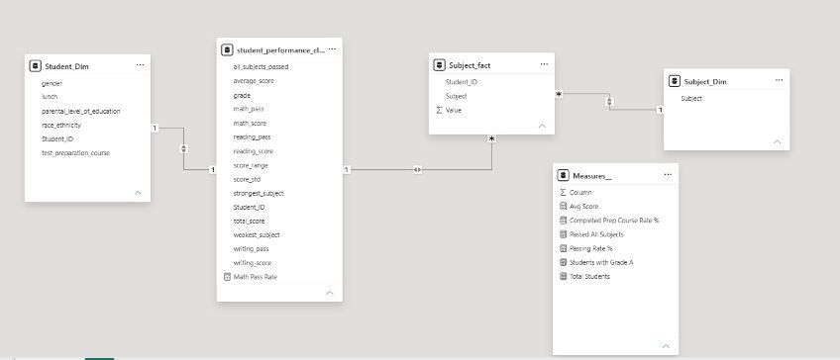
Power Bi Modeling:

Slide 16
Business Problem & Objectives:
Problem Statement:
Schools need to understand students' academic performance and identify areas where students may need additional support.
Objectives:
Measure overall academic performance.
Compare Math, Reading, and Writing.
Analyze the effect of student characteristics.
Identify factors associated with higher performance.
Build an interactive dashboard for decision-making.

Slide 17
Data Visualization
Samsung Innovation Campus
Notes:
Note:
2

Slide 18
Why Power BI?
  Power BI was used to transform the analytical results into an interactive dashboard.
Visualization choices:
KPI Cards → quick performance overview
Bar/Column Charts → compare groups
Donut Chart → show proportions
Line/Area Chart → show trends if applicable
Slicers → interactive filtering
Samsung Innovation Campus

Slide 19
Dashboard:
Samsung Innovation Campus
Notes:
Note:
2

Slide 20
Dashboard Story & Insights​:
1. Overall Performance
KPI cards show the total number of students, average score, and passing rate.
2. Subject Comparison
Users can identify the strongest and weakest subjects.
3. Student Groups
Performance can be compared based on gender, lunch, parental education, and race/ethnicity.
4. Test Preparation
The dashboard highlights the difference between students who completed and did not complete the preparation course.
5. Interactive Analysis
Slicers allow users to drill down into specific groups.

Slide 21
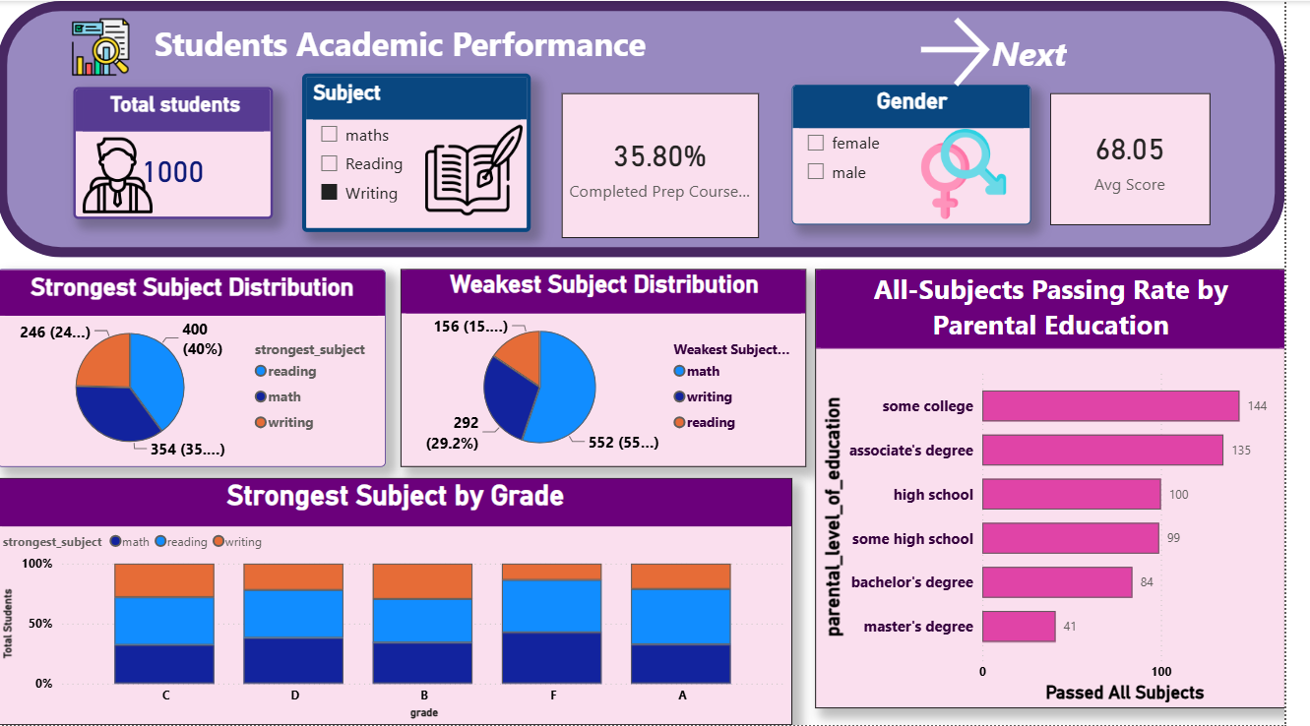
The dashboard provides an overview of student performance and allows users to explore performance by subject and student characteristics.
Samsung Innovation Campus

Slide 22
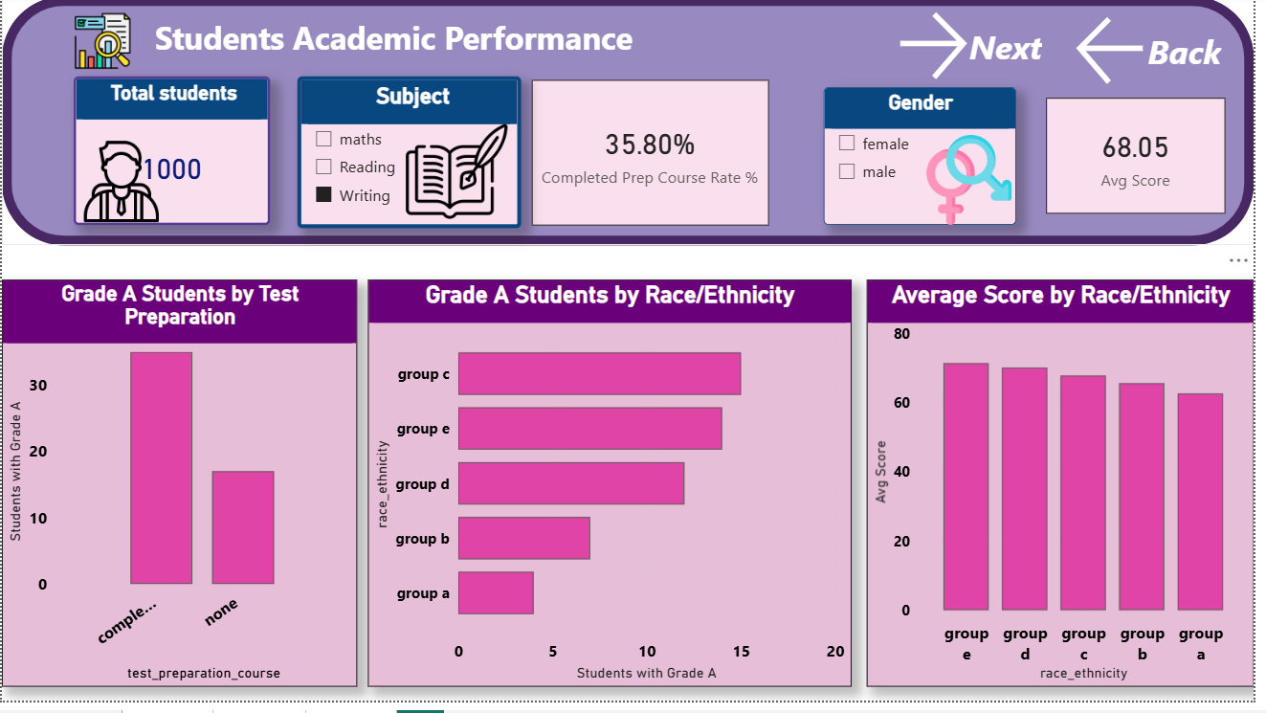

Slide 23
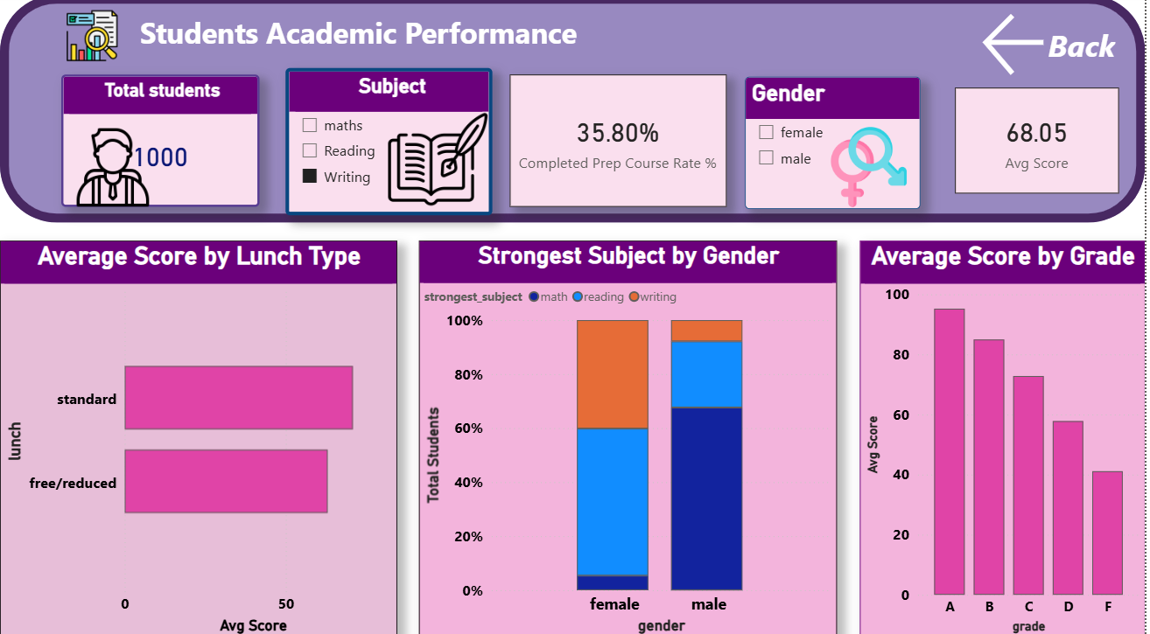

Slide 24
Conclusion
Samsung Innovation Campus
Notes:
Note:
2

Slide 25
The analysis provided an overview of students' academic performance.
Reading and Writing showed stronger performance compared to Math.
Test preparation was associated with better student performance.
Some differences were observed between student groups.
The Power BI dashboard helps users easily explore and understand these patterns.
Recommendation:
  Schools can use performance data to identify students who need additional academic support and encourage participation in test preparation programs.

Slide 26

ⓒ2020 SAMSUNG. All rights reserved.
Samsung Electronics Corporate Citizenship Office holds the copyright of book.
This book is a literary property protected by copyright law so reprint and reproduction without permission are prohibited.
To use this book other than the curriculum of Samsung innovation Campus or to use the entire or part of this book, you must receive written consent from copyright holder.
Notes:
14

